Slide 1


Cristian Niță
11/12/2023

Slide 2

Outline
Executive Summary
Introduction
Methodology
Results
Conclusion
Appendix

Slide 3
Executive Summary
The data analysis employed the following approaches:
Gathered data through web scraping and the SpaceX API.
Conducted Exploratory Data Analysis (EDA), encompassing data wrangling, visualization, and interactive visual analytics.
Employed Machine Learning Prediction techniques.
Summary of all results
Valuable data was successfully acquired from publicly available sources.
Through EDA, key features influencing the success of launches were identified.
Machine Learning Prediction revealed the optimal model for predicting crucial characteristics that enhance the success of launch opportunities, leveraging the comprehensive dataset.

Slide 4
Introduction
SpaceX has disrupted the space industry by offering Falcon 9 launches at just 62 million dollars, significantly undercutting competitors. Their groundbreaking idea of reusing the first stage through precise re-landing drives these cost savings. As a data scientist for a startup rivaling SpaceX, our project aims to predict first-stage landing outcomes using machine learning, crucial for bidding competitively. Challenges include identifying key landing factors, understanding variable relationships, and determining optimal conditions for success.
The objective for Space Y, a new player, is to assess its competitiveness against SpaceX. Our focus is on predicting successful first-stage landings to estimate total launch costs effectively. Additionally, the analysis aims to identify optimal launch locations, providing strategic insights for Space Y's market positioning and competition with SpaceX.

Slide 5

Section 1

Slide 6
Methodology
Executive Summary
Data collection methodology:
Data from Space X was obtained from 2 sources:
Space X API (https://api.spacexdata.com/v4/rockets/)
• Web Scraping (https://en.wikipedia.org/wiki/List_of_Falcon/_9/_and_Falcon_Heavy_launches)
Perform data wrangling
The collected data was enhanced through the incorporation of a landing outcome label, which was generated by summarizing and analyzing the outcome data associated with the features.

Slide 7
Methodology
Executive Summary
Perform exploratory data analysis (EDA) using visualization and SQL
Perform interactive visual analytics using Folium and Plotly Dash
Perform predictive analysis using classification models
How to build, tune, evaluate classification models

Slide 8
Data Collection
Data collection is a systematic process that involves gathering information on specific variables within an established system. This process is essential for addressing questions and evaluating outcomes.
The dataset was obtained through two primary methods: REST API and Web Scraping from Wikipedia.
For REST API, the process initiated with a get request. The response content was decoded as JSON and transformed into a pandas dataframe using json_normalize(). Following this, data cleaning procedures were applied, including addressing and filling missing values.
Web scraping involved the utilization of BeautifulSoup to extract launch records presented as an HTML table. The table was then parsed and converted into a pandas dataframe for subsequent analysis.

Slide 9
Data Collection – SpaceX API
SpaceX provides a public API that allows users to access and utilize data.
Following the flowchart depicted alongside, the data is acquired through this API and subsequently persisted.
Source on GitHub: https://github.com/NitaCristian/Applied-Data-Science-Capstone/blob/master/1_Data_Collection_API.ipynb
Request API and parse the SpaceX launch data
Filter the data to exclusively encompass Falcon 9 launches.
Addressing Missing Values

Slide 10
Data Collection - Scraping
Obtaining data from SpaceX launches is also feasible through Wikipedia.
The data is downloaded from Wikipedia in accordance with the provided flowchart and subsequently persisted.
Source on GitHub: https://github.com/NitaCristian/Applied-Data-Science-Capstone/blob/master/2_Data_Collection_With_Web_Scraping.ipynb
Retrieve the Falcon 9 Launch Wiki page from the specified URL.
Generate a BeautifulSoup object from the HTML response.
Retrieve all column/variable names from the HTML header.

Slide 11
Data Wrangling
Data wrangling involves the cleanup and unification of intricate datasets, simplifying access for Exploratory Data Analysis (EDA).
Our initial steps include computing the number of launches at each site and determining the count and occurrence of mission outcomes per orbit type.
Subsequently, we generate a landing outcome label from the outcome column to facilitate subsequent analysis, visualization, and machine learning applications.
Finally, the results will be exported to a CSV file for further use.
Source on GitHub: https://github.com/NitaCristian/Applied-Data-Science-Capstone/blob/master/3_Data_Wrangling.ipynb

Slide 12
Data Wrangling
Clean datasets
Calculate launches per site
Determine mission outcomes per orbit type
Create landing outcome label from the outcome column
Export results to a CSV file
Source on GitHub: https://github.com/NitaCristian/Applied-Data-Science-Capstone/blob/master/3_Data_Wrangling.ipynb

Slide 13
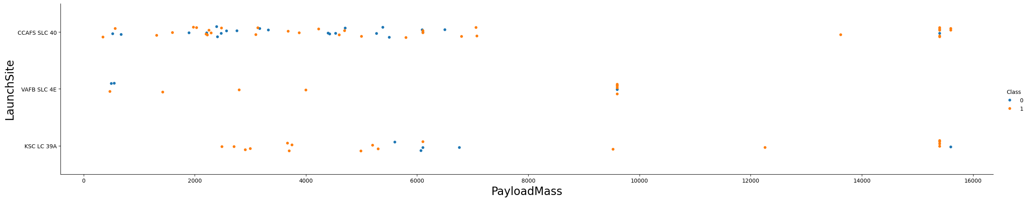
EDA with Data Visualization
To explore the data, scatterplots and bar plots were employed to visualize the relationship between various pairs of features, such as:
Payload Mass X Flight Number
Launch Site X Flight Number
Launch Site X Payload Mass
Orbit and Flight Number
Payload and Orbit
Source on GitHub: https://github.com/NitaCristian/Applied-Data-Science-Capstone/blob/master/5_EDA_With_Visualization.ipynb

Slide 14
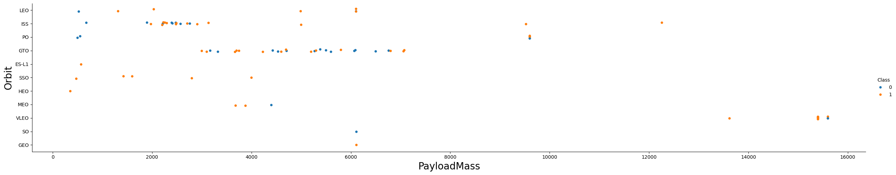
EDA with Data Visualization
The initial step involved using scatter graphs to discern the relationships between attributes .
Scatter plots effectively illustrate the dependency of attributes on each other. Once patterns are identified from these graphs, it becomes straightforward to ascertain which factors most significantly impact the success of landing outcomes.
Source on GitHub: https://github.com/NitaCristian/Applied-Data-Science-Capstone/blob/master/5_EDA_With_Visualization.ipynb

Slide 15
EDA with SQL
Using SQL, we conducted a series of queries to gain valuable insights into the dataset:
Displayed the names of the unique launch sites.
Listed 5 records where launch sites begin with the string ‘CCA’.
Showcased the total payload mass carried by NASA (CRS) boosters.
Presented the average payload mass carried by booster version F9 v1.1.
Identified the date of the first successful landing outcome on a ground pad.
Listed the names of boosters with success on a drone ship and payload mass between 4000 and 6000 kg.
Source on GitHub: https://github.com/NitaCristian/Applied-Data-Science-Capstone/blob/master/4_EDA_With_SQL.ipynb

Slide 16
EDA with SQL
Using SQL, we conducted a series of queries to gain valuable insights into the dataset:
Provided the total number of successful and failure mission outcomes.
Identified the booster versions carrying the maximum payload mass.
Extracted information on failed landing outcomes on a drone ship, including booster versions and launch site names in the year 2015.
Ranked the count of landing outcomes (e.g., Failure (drone ship) or Success (ground pad)) between the dates 2010-06-04 and 2017-03-20 in descending order.
Source on GitHub: https://github.com/NitaCristian/Applied-Data-Science-Capstone/blob/master/4_EDA_With_SQL.ipynb

Slide 17
Build an Interactive Map with Folium
Folium Maps incorporated markers, circles, lines, and marker clusters for an interactive launch data visualization. Markers identified points like launch sites, circles highlighted areas (e.g., NASA Johnson Space Center), marker clusters grouped events at each coordinate, and lines indicated distances between coordinates.
The interactive map displayed launch data by adding circle markers around each launch site, featuring labels with site names. Launch outcomes (failure, success) were distinguished by Red and Green markers in a MarkerCluster. Haversine’s formula calculated distances to landmarks, answering questions about launch site proximity to railways, highways, coastlines, and nearby cities.
Source on GitHub: https://github.com/NitaCristian/Applied-Data-Science-Capstone/blob/master/6_Interactive_Visual_Analytics_With_Folium.ipynb

Slide 18
Build a Dashboard with Plotly Dash
An interactive Plotly Dash dashboard was developed to provide users with the flexibility to explore the data.
Pie charts were utilized to visualize the percentage of launches by different sites, offering a comprehensive overview. Additionally, scatter graphs were plotted to depict the relationship between outcomes and payload mass (in kilograms) for various booster versions.
This combination of visualizations enables a rapid analysis of the connection between payloads and launch sites, aiding in the identification of optimal launch locations based on payload considerations.
Source on GitHub: https://github.com/NitaCristian/Applied-Data-Science-Capstone/blob/master/7_Build_Dashboard_Application_With_Plotly_Dash.py

Slide 19
Predictive Analysis (Classification)
Four classification models were compared: logistic regression, support vector machine, decision tree and k nearest neighbors.
The models were checked for their accuracy, then we obtained tuned hyperparameters for each algorithm and the plot the confusion matrix.
Source on GitHub: https://github.com/NitaCristian/Applied-Data-Science-Capstone/blob/master/8_Machine_Learning_Prediction.ipynb
Data preparation and standardization
Test of each model with combinations of hyperparameters
Comparison of results

Slide 20
Results
Exploratory data analysis results
F9 v1.1 booster's average payload: 2,928 kg.
The first successful landing occurred in 2015, five years after the initial launch.
Many Falcon 9 booster versions successfully landed on drone ships with payloads exceeding the average.
Nearly 100% of mission outcomes were successful.
In 2015, two booster versions (F9 v1.1 B1012 and F9 v1.1 B1015) failed to land on drone ships.
Landing outcomes consistently improved over the years.
Interactive analytics demo in screenshots
Launch sites are strategically located in safe areas, often near the sea, with robust logistic infrastructure.
The majority of launches take place at east coast launch sites.
Predictive analysis results
Using Decision Tree Classifier:
Accuracy exceeds 87%.
Test data accuracy surpasses 94%.

Slide 21

Section 2

Slide 22
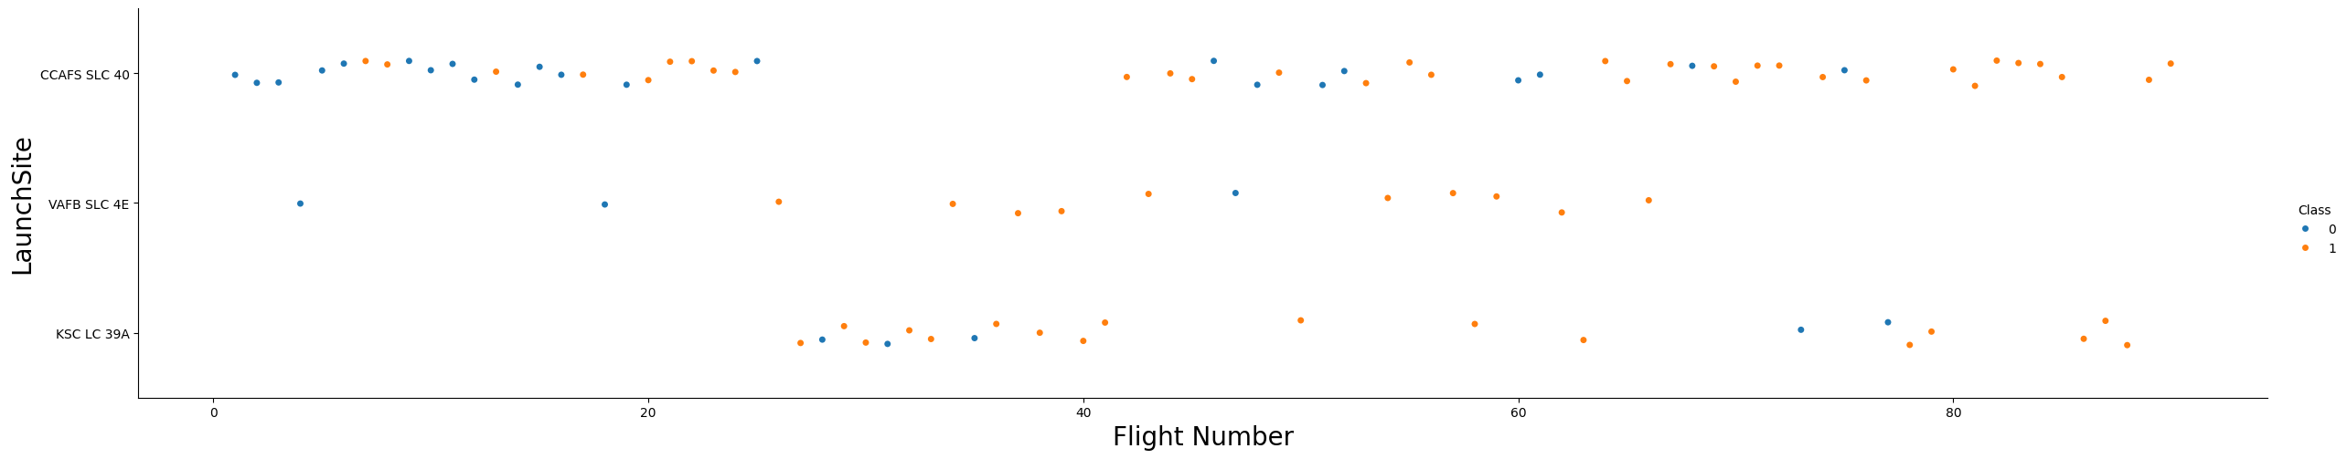
Flight Number vs. Launch Site
According to the plot above, it’s possible to verify that the best launch site nowadays is CCAF5 SLC 40, where most of recent launches were successful;
In second place VAFB SLC 4E and third place KSC LC 39A;
It’s also possible to see that the general success rate improved over time

Slide 23
Payload vs. Launch Site
Payloads over 9,000kg (about the weight of a school bus) have excellent success rate;
Payloads over 12,000kg seems to be possible only on CCAFS SLC 40 and KSC LC 39A launch sites.

Slide 24
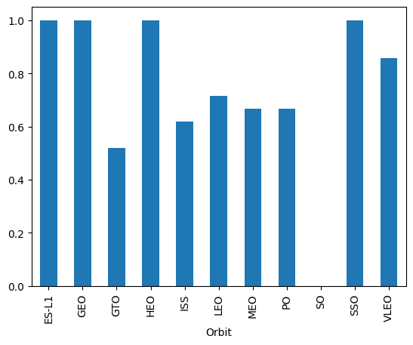
Success Rate vs. Orbit Type
The biggest success rates happens to orbits:
ES-L1;
GEO;
HEO; and
SSO.
Followed by:
VLEO (above 80%); and
LFO (above 70%).

Slide 25
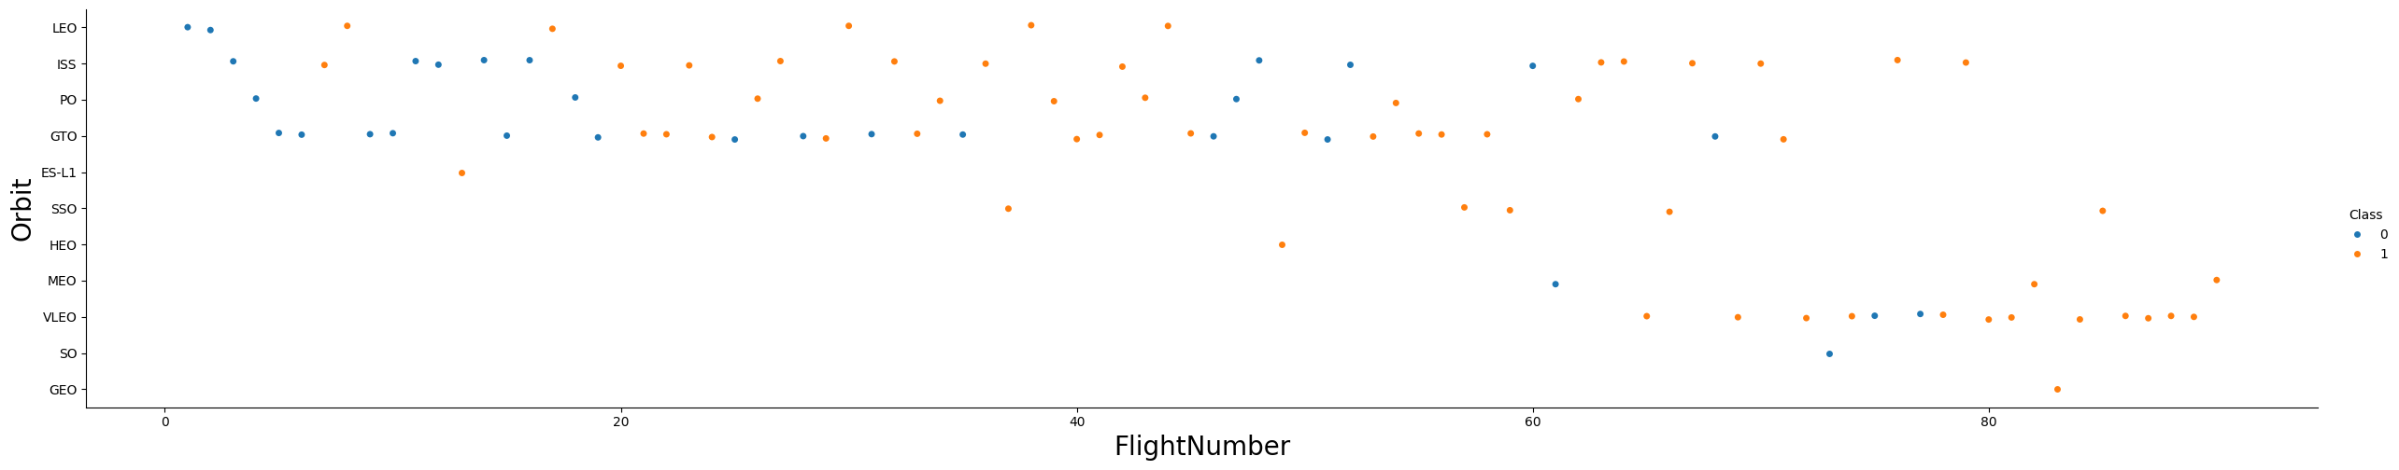
Flight Number vs. Orbit Type
Apparently, success rate improved over time to all orbits;
VLEO orbit seems a new business opportunity, due to recent increase of its frequency.

Slide 26
Payload vs. Orbit Type
Apparently, there is no relation between payload and success rate to orbit GTO;
ISS orbit has the widest range of payload and a good rate of success;
There are few launches to the orbits SO and GEO.

Slide 27
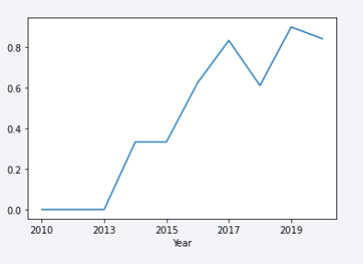
Launch Success Yearly Trend
Success rate started increasing in 2013 and kept until 2020;
It seems that the first three years were a period of adjusts and improvement of technology

Slide 28
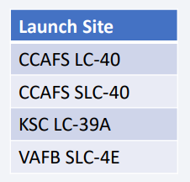
All Launch Site Names
Find the names of the unique launch sites
They are obtained by selecting unique occurrences of “launch_site” values from the dataset.

Slide 29
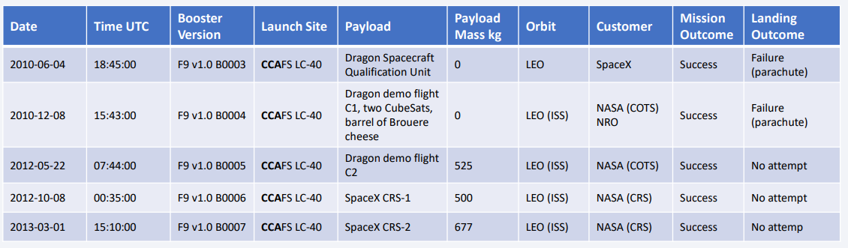
Launch Site Names Begin with 'CCA'
Find 5 records where launch sites begin with `CCA`
Here we can see five samples of Cape Canaveral launches.

Slide 30
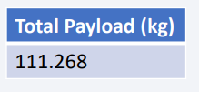
Total Payload Mass
Calculate the total payload carried by boosters from NASA
Total payload calculated above, by summing all payloads whose codes contain ‘CRS’, which corresponds to NASA.

Slide 31
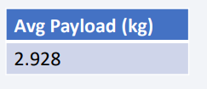
Average Payload Mass by F9 v1.1
Calculate the average payload mass carried by booster version F9 v1.1
Filtering data by the booster version above and calculating the average payload mass we obtained the value of 2,928 kg.

Slide 32
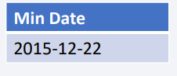
First Successful Ground Landing Date
Find the dates of the first successful landing outcome on ground pad
By filtering data by successful landing outcome on ground pad and getting the minimum value for date it’s possible to identify the first occurrence, that happened on 12/22/2015.

Slide 33
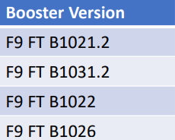
Successful Drone Ship Landing with Payload between 4000 and 6000
List the names of boosters which have successfully landed on drone ship and had payload mass greater than 4000 but less than 6000
Selecting distinct booster versions according to the filters above, these 4 are the result.

Slide 34
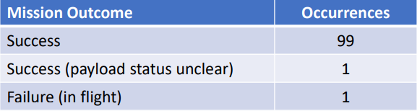
Total Number of Successful and Failure Mission Outcomes
Calculate the total number of successful and failure mission outcomes
Grouping mission outcomes and counting records for each group led us to the summary above.

Slide 35
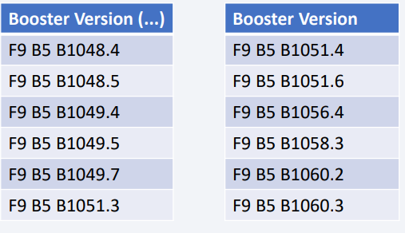
Boosters Carried Maximum Payload
List the names of the booster which have carried the maximum payload mass
These are the boosters which have carried the maximum payload mass registered in the dataset.

Slide 36
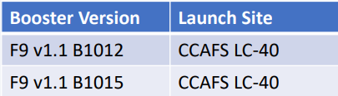
2015 Launch Records
List the failed landing outcomes in drone ship, their booster versions, and launch site names for in year 2015
The list above has the only two occurrences.

Slide 37
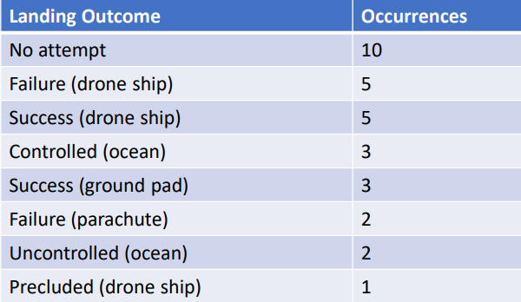
Rank Landing Outcomes Between 2010-06-04 and 2017-03-20
Rank the count of landing outcomes (such as Failure (drone ship) or Success (ground pad)) between the date 2010-06-04 and 2017-03-20, in descending order
This view of data alerts us that “No attempt” must be taken in account.

Slide 38

Section 3

Slide 39
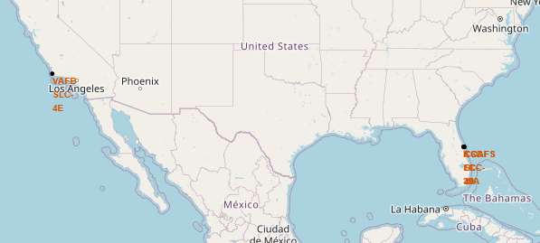
Location of all the Launch Sites
We can see that all the SpaceX launch sites are located inside the United States.

Slide 40
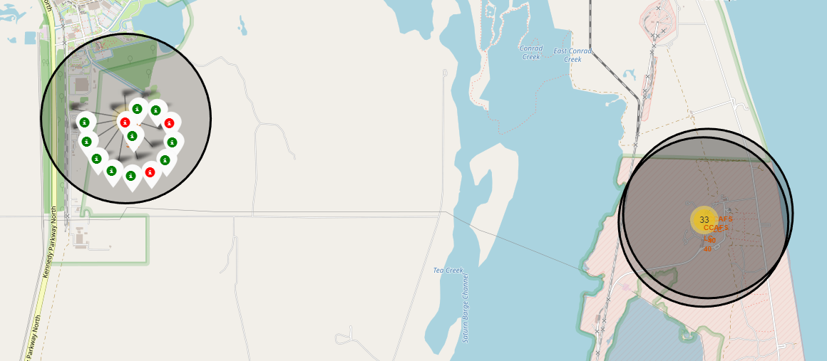
Markers showing launch sites with color labels
• Example of KSC LC-39A launch site launch outcomes.

Slide 41
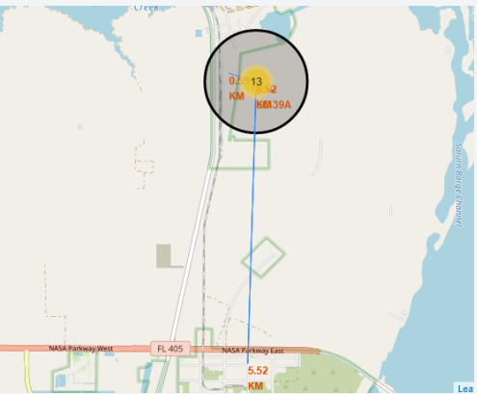
Logistics and Safety
Launch site KSC LC-39A has good logistics aspects, being near railroad and road and relatively far from inhabited areas.

Slide 42

Section 4

Slide 43
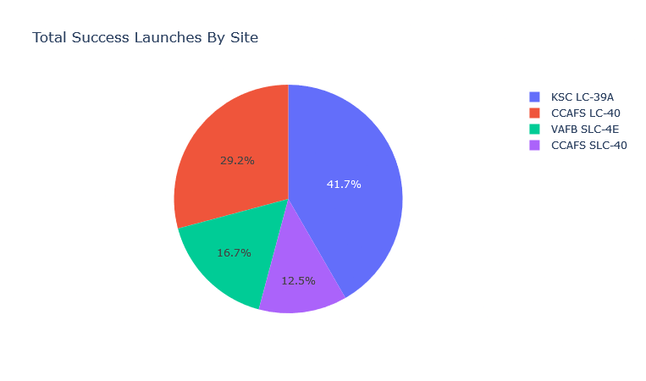
The success percentage by each sites.

Slide 44
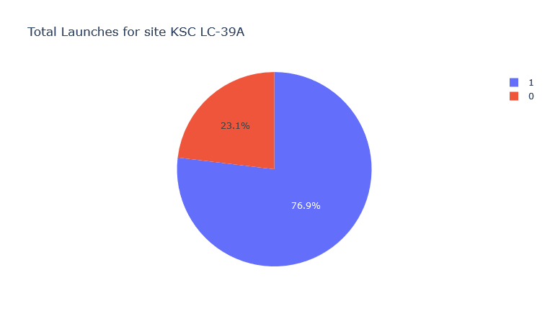
The highest launch-success ratio: KSC LC-39A

Slide 45
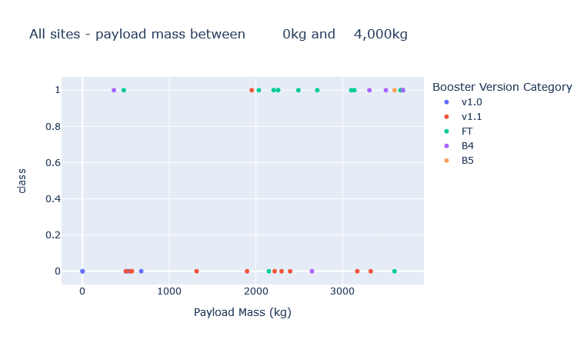
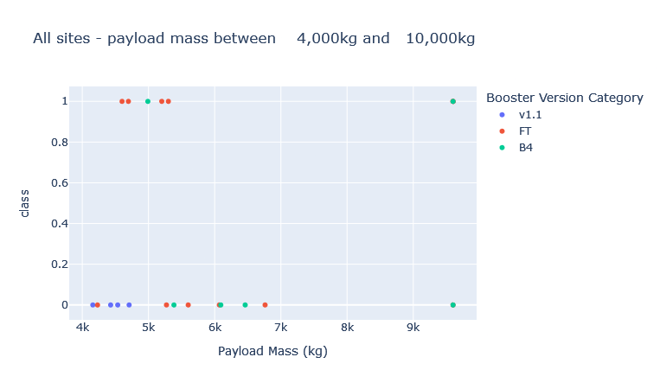
Payload vs Launch Outcome Scatter Plot

Slide 46

Section 5

Slide 47
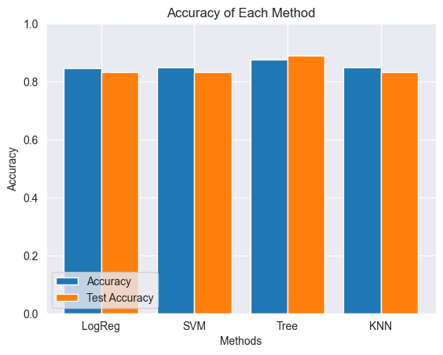
Classification Accuracy
Four classification models were tested, and their accuracies are plotted beside;
The model with the highest classification accuracy is Decision Tree Classifier, which has accuracies over than 87%.

Slide 48
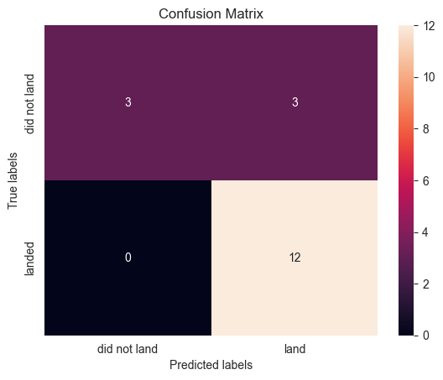
Confusion Matrix
The confusion matrix for the decision tree classifier shows that the classifier can distinguish between the different classes. The major problem is the false positives .i.e., unsuccessful landing marked as successful landing by the classifier.

Slide 49
Conclusions
The Decision Tree Classifier Algorithm emerges as the optimal machine learning approach for this dataset.
Low-weighted payloads (defined as 4000kg and below) outperform heavy-weighted payloads.
From 2013 onward, the success rate for SpaceX launches has shown a consistent increase, suggesting ongoing improvement.
KSC LC-39A stands out with the highest success rate of 76.9% among all launch sites.
SSO orbit boasts a remarkable success rate of 100% with multiple occurrences.
KSC LC-39A is identified as the premier launch site.
Launches with payloads above 7,000kg exhibit lower risk.
While most mission outcomes are successful, the success of landing outcomes appears to improve over time, reflecting advancements in processes and rocket technology.
Leveraging the Decision Tree Classifier for predictive analysis proves valuable in forecasting successful landings and enhancing profitability.

Slide 50
Appendix
All assets are shown in the GitHub repository.

Slide 51


